Slide 1
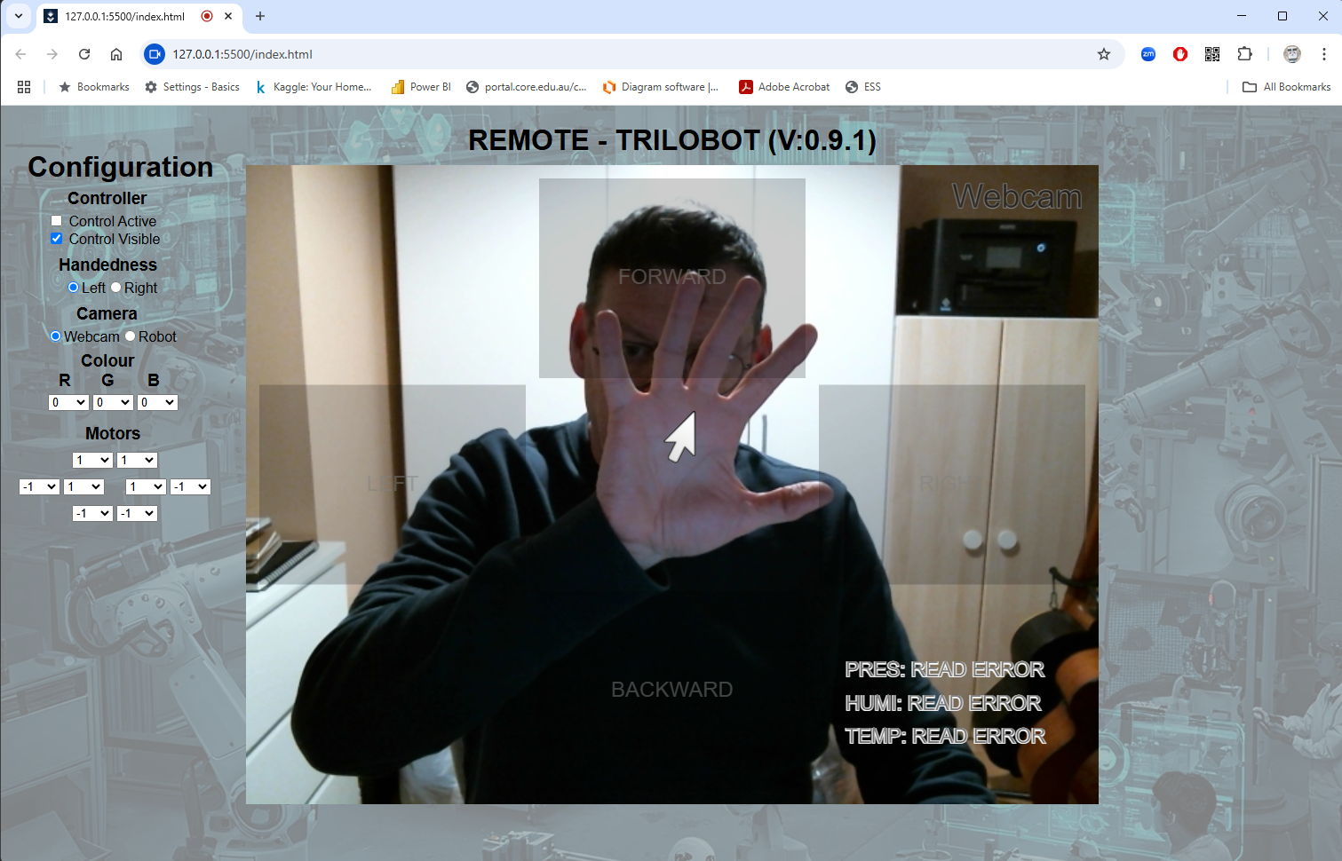
Trilobot Challenge
In this activity you will drive a Trilobot using Google’s MediaPipe AI Models to recognise hand movements from a webcam feed.
The basic idea is you will complete a set of challenges as quickly as possible. But there’s a catch, you need to tailor the power to the motors to make the movements as controllable as possible but at the same time fast enough to allow complete the challenges using only hand movements in front of the webcam.

Slide 2
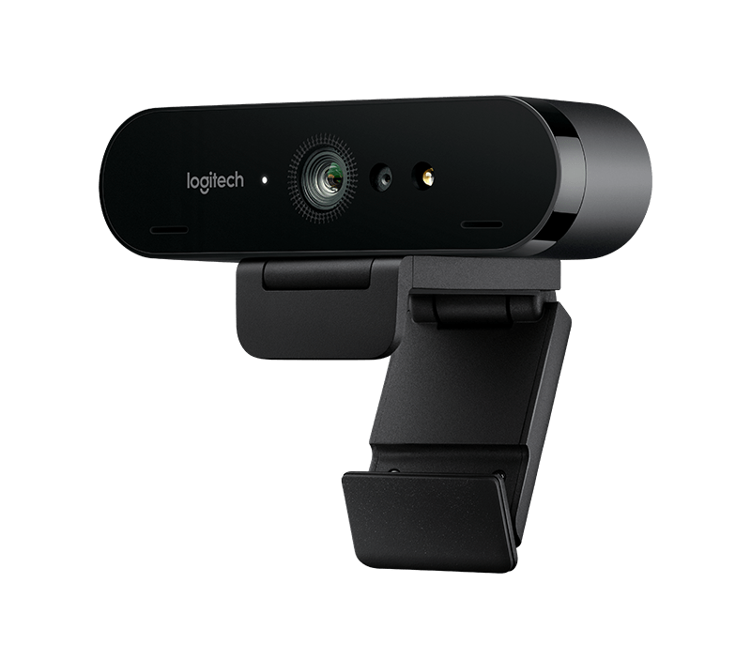
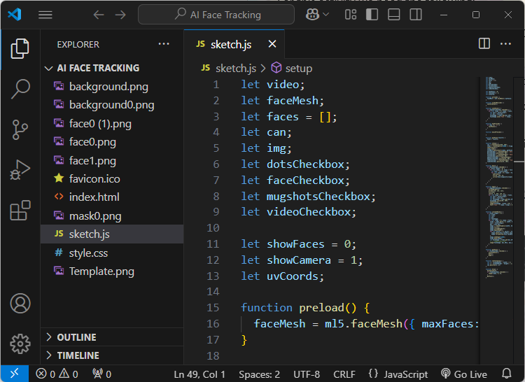
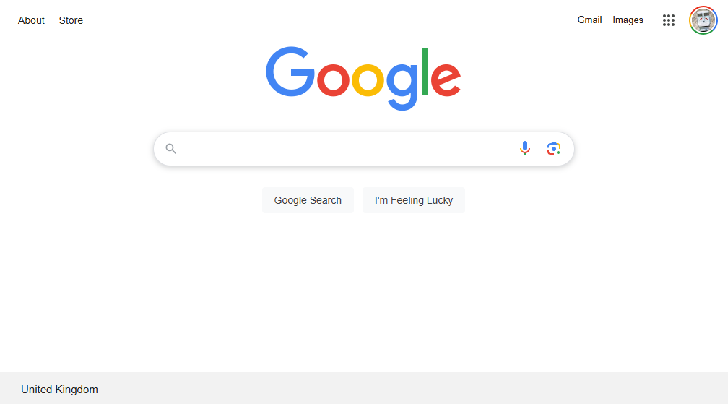
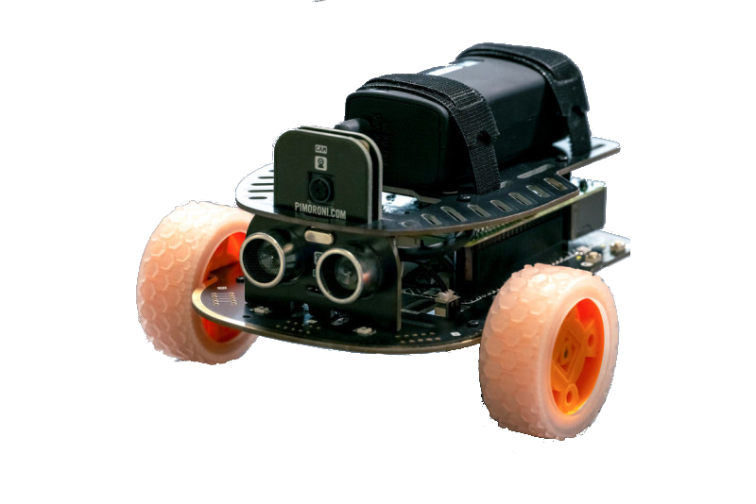
Let’s get going!
What do we need!
For this activity we need the following:
A web browser (we recommend you use Chrome).
The VS Code Editor
A webcam connected to the computer.
A Trilobot (Obviously!)
Your hand.
The lab computers should already be setup, but if you get stuck at any point, ask for help. We are here to help you.
Oh, you also need your cunning plan!
Source files: https://github.com/neliot/Trilobot

Slide 3
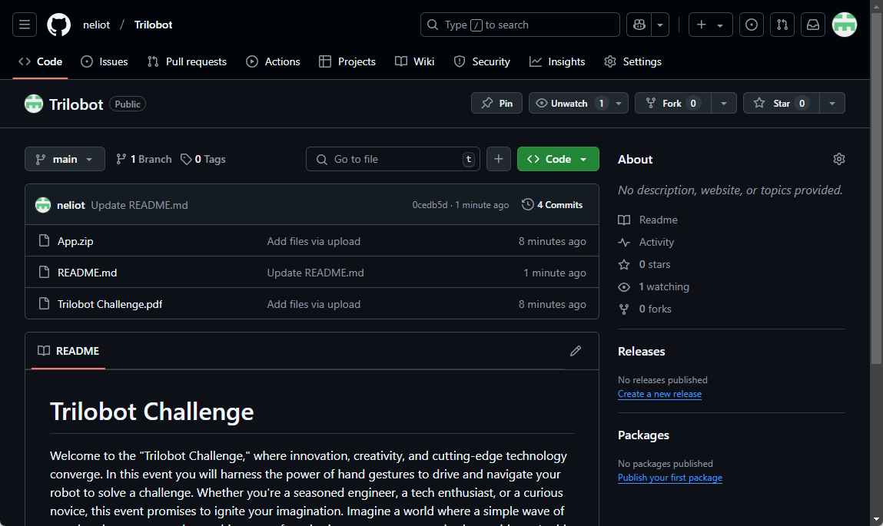
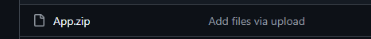
Let’s get going!
Download the application!
In your browser enter the URL below:
https://github.com/neliot/Trilobot
You should see a page similar to the one below:
Click on the App.zip file:

Slide 4
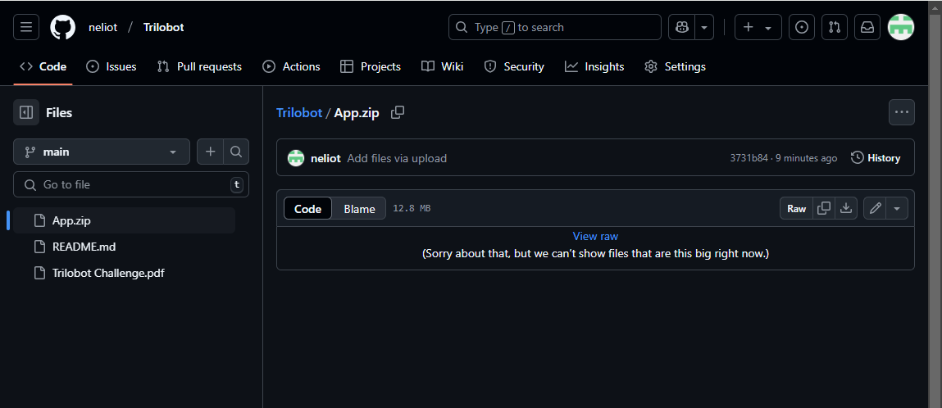
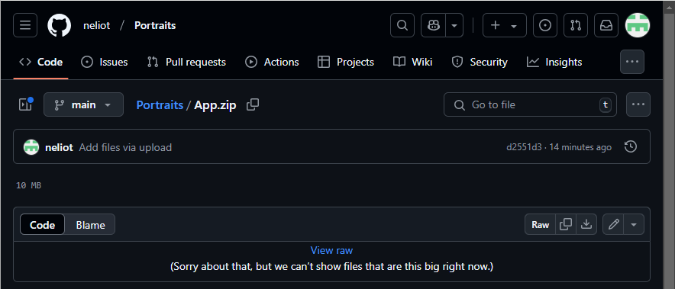
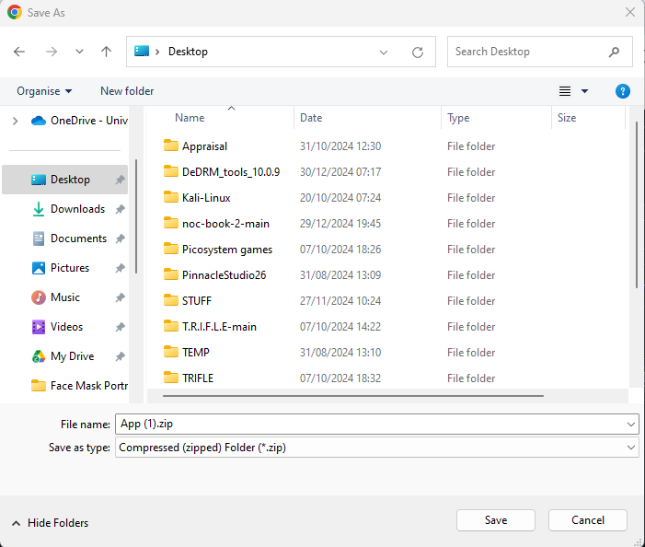
Let’s get going!
Download the application!
You will now be presented with the following screen:
Click on the download icon and save the file to the Desktop.

Slide 5
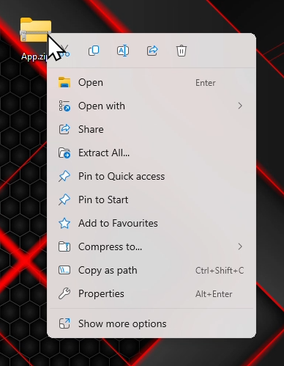
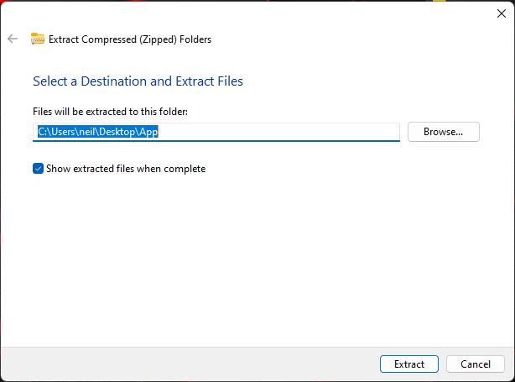
Let’s get going!
Extract the application!
Go to the desktop and find the file you just downloaded and right click on it.
Select Extract All and then Extract.

Slide 6
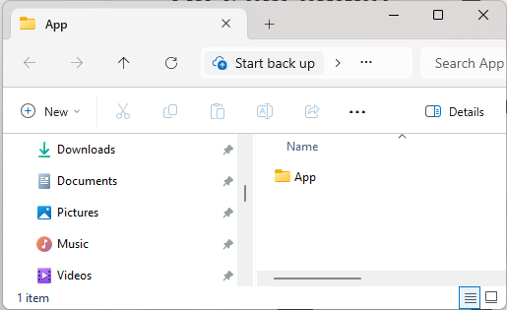
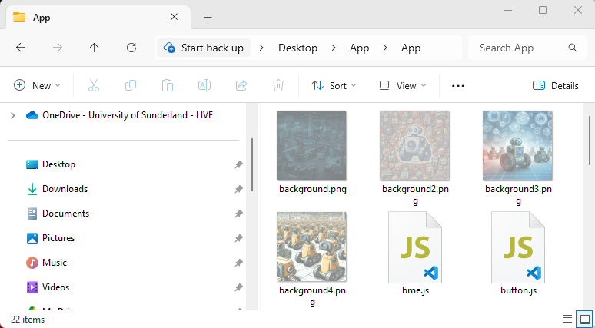
Let’s get going!
Setup the application!
You can now see the Extracted application folder.
Go into the App folder by double clicking on it.

Slide 7
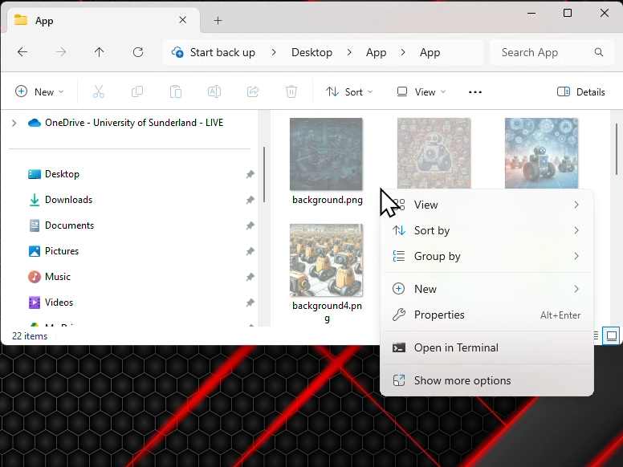
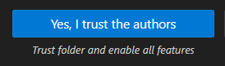
And now the Editor
Setup the application!
Right Click in the white space for the action menu as below:
Select the Open in Terminal option. When the terminal window opens go to it and type in “code .” (without the quotes, yes, a dot is required after code!). Press the RETURN key. You should now have VS Code running with the App folder showing the files. If you get a message asking if you Trust this folder select Yes.

Slide 8
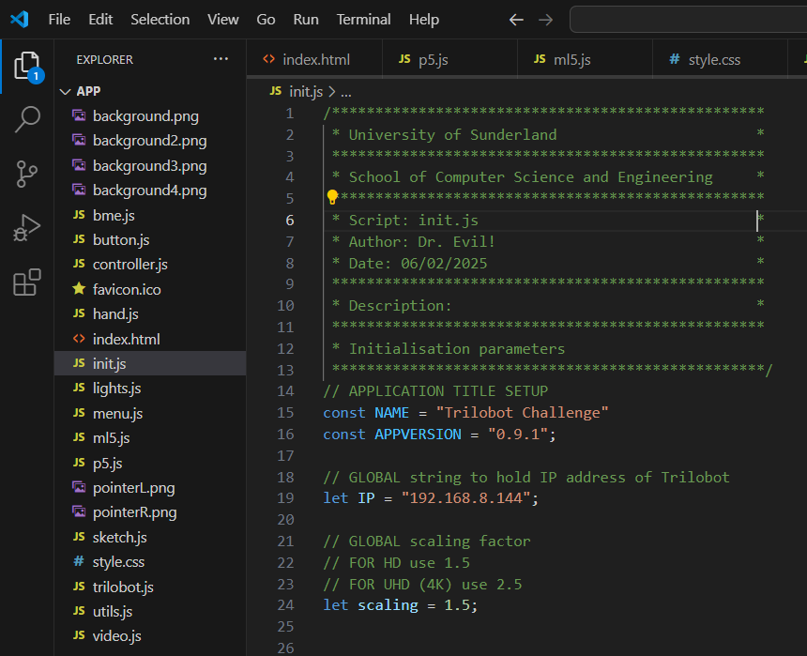
And now the Editor
Setup the application!
Within the list of files (there are quite a few) there is a file named init.js This file contains needs to have the IP address of the root you will control added to it. Select the file and the code will appear in the editor.
You will be given the address of the robot you are going to control by the person running the event. You need to change the address to the one you are given.

Slide 9
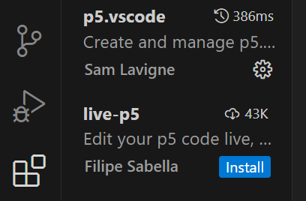
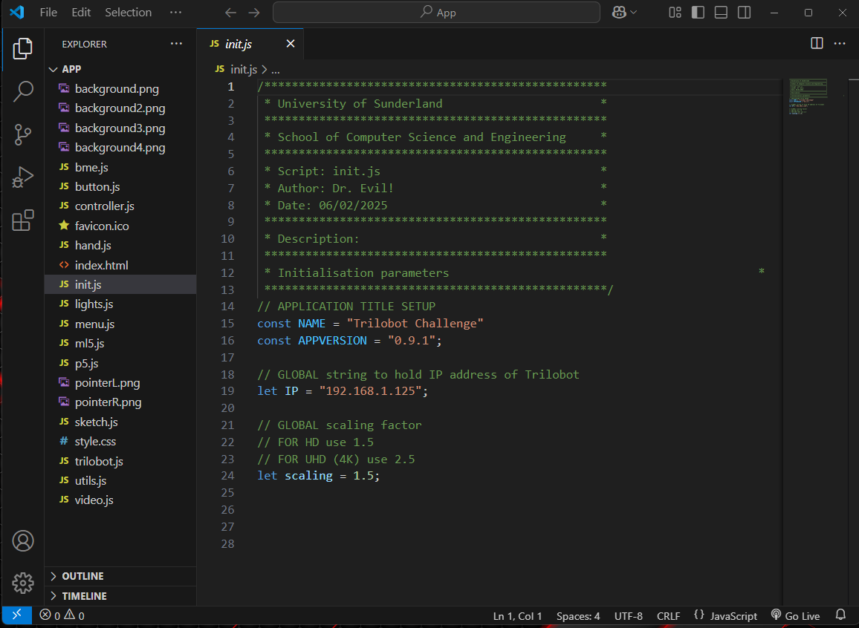
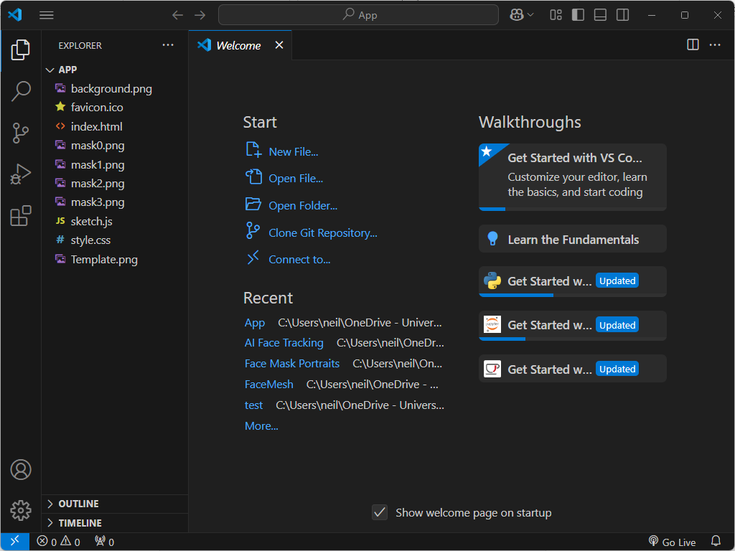
And now the Editor
Running the application!
Now you can launch the application. At the bottom of the screen is an option “Go Live”. This is the built in Live Server which is a local web server which runs the application.
If the “Go Live” option isn’t displayed call the academic over, they may need to install the p5.vscode extension for you!

Slide 10
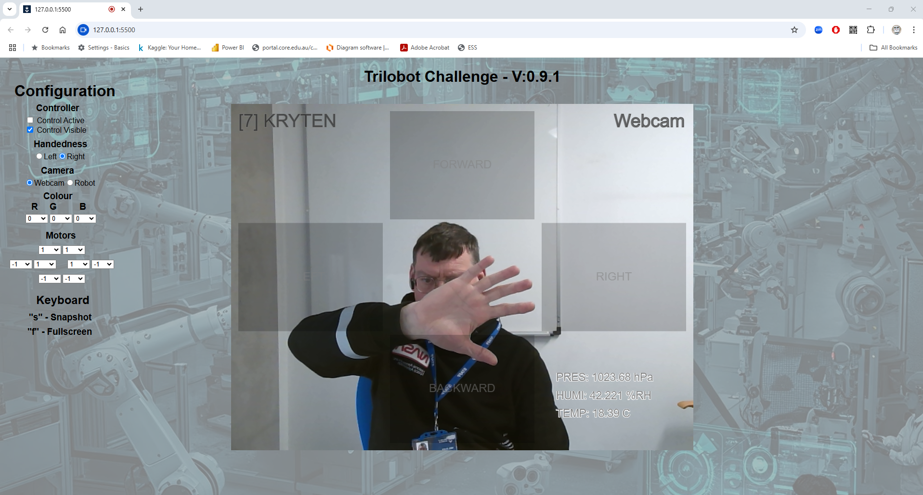
Trilobot Challenge
Running the application!
This application will now be launched in the default browser and should look similar to the image below.
The “Configuration” panel is where you can manipulate the main “video feed” and overlaid on the video feed is the main “application” interface.
The next two pages will go over the interface.

Slide 11
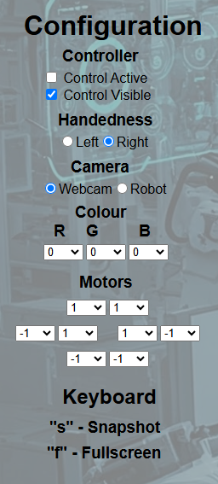
Trilobot Challenge
Using the interface!
The “configuration” panel operations are detailed below:
The main hand gesture “buttons” can be made inactive so the robot doesn’t respond and can also be hidden.
This allows the system to recognise either your left or right hand.
This changes the overall video panel between the webcam and the robot mounted camera.
Selecting the RGB colours (0-255) changes the underlighting of the robot.
These values determine the motor power to each wheel allowing you to “calibrate” the movement.
s – Takes a snapshot of the current video view.
f – Expands the web browser to full screen.

Slide 12
Trilobot Challenge
Using the interface!
The “configuration” panel operations are detailed below:
Trilobot name and number
Hand gesture “buttons” for FORWARDS etc.
Current video feed.
Video feed.
Environmental data.

Slide 13
Trilobot Challenge
Anagram Challenge!
Introduction
You will probably know many gameshows that use anagrams as a way pitting contestants against each other. Wel in this challenge it’s the same, but with a twist. You are going to experience robotics and artificial intelligent (AI), not to solve the anagram but to find the letters in the anagram!
You will have to search for the letters remotely using a robot that is controlled by you simply waving your hands.
Your Challenge
You are now the operator of the Trilobot inspection robot system, and you are required to search an area to find the letters. They are quite easy to identify, they will be located on the floor, stood upright and easily readable from the robot camera view.
You must collect identify all the letters. You will be told how many there are and solve the anagram. First one to do it wins!

Slide 14
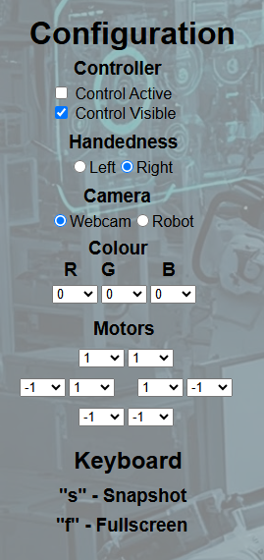
Trilobot Challenge
Anagram Challenge!
Stage 1
Before you carry out the letter search you need to consider how your Trilobot moves.
We know the terrain is flat and easy to manoeuvre in, but every robotic system needs to be calibrated, importantly, it needs to move in a way that the operator will feel most comfortable.
Calibration
The Configuration panel allows you to change camera views etc. to tailor the interface. Spend some time (about 15 mins) using the Configuration section and get the robot setup so you are comfortable driving it around. You will need to adjust the motor speeds and handedness.
The “Webcam” view will allow you to see how the motion is triggered. You can then switch back to the robot view.

Slide 15

Trilobot Challenge
Stage 2
Once you are comfortable with controlling the robot you can move onto the search stage.
Drive the robot around the area and find all the letters. When you find a letter remove the controller buttons from the display and take a snapshot of the letter. (you must have each letter photographed to win).
Continue navigating around the area until you have found all the letters and have taken an unobscured photo of them.
Once you have all the photos navigate back out to the starting point. Once at that the exit you must solve the anagram and show the photos and the “word” to win.

Slide 16
And Finally!
Creating basic applications with AI is just the tip of the iceberg.
AI now empowers us to revolutionize industries, enhance everyday life, and solve complex problems in ways we never thought possible.
What we have seen here is just a simple AI powered robotic control system.
Future possibilities are vast and exciting, and you can be a part of it!

Slide 17
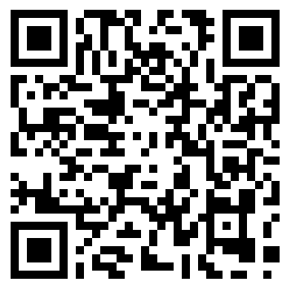
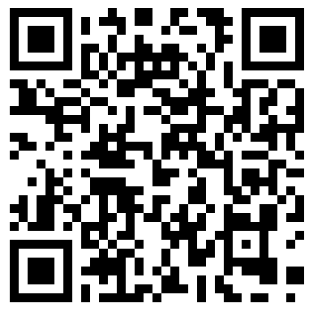
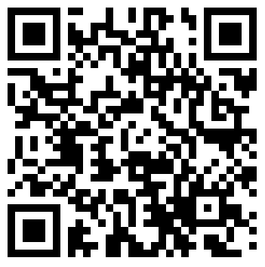
On the BSc Computer Science Programme at the University of Sunderland you'll study AI and Machine Learning in more detail, which means you'll be able to create some amazing things and have a good grasp on this important emerging technology.
BSc Computer Science
Other Programmes that may be of interested
BSc Cybersecurity
and Digital Forensics
BSc Games Development

